Slide 1
Difference in two means
Slides developed by Mine Çetinkaya-Rundel of OpenIntro
Translated from LaTeX to Google Slides by Curry W. Hilton of OpenIntro.
The slides may be copied, edited, and/or shared via the CC BY-SA license
Some images may be included under fair use guidelines (educational purposes)

Slide 2

Diamonds
Weights of diamonds are measured in carats
1 carat = 100 points, 0.99 carats = 99 points, etc.
The difference between the size of a 0.99 carat diamond and a 1 carat diamond is undetectable to the naked human eye, but does the price of a 1 carat diamond tend to be higher than the price of a 0.99 diamond?
We are going to test to see if there is a difference between the average prices of 0.99 and 1 carat diamonds. (GOAL)
In order to be able to compare equivalent units, we divide the prices of 0.99 carat diamonds by 99 and 1 carat diamonds by 100, and compare the average point prices

Slide 3
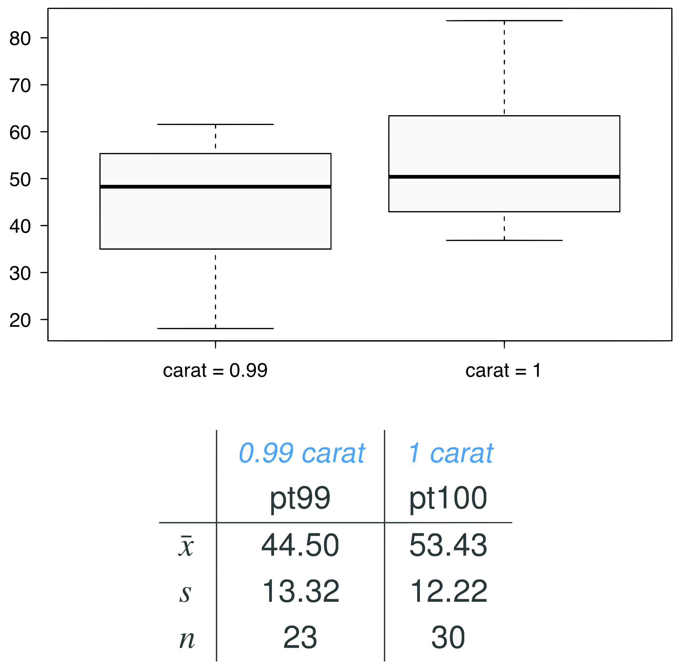
Data
Note: These data are a random sample from the diamonds data set in ggplot2 R package.

Slide 4


Parameter and point estimate
Parameter of interest: Average difference between the point prices of all 0.99 carat and 1 carat diamonds
Point estimate: Average difference between the point prices of sampled 0.99 carat and 1 carat diamonds

Slide 5


Hypotheses
Which of the following is the correct set of hypotheses for testing if the average point price of 1 carat diamonds (pt100) is higher than the average point price of 0.99 carat diamonds (pt99)?
H₀ : 𝞵_{pt99} = 𝞵_{pt100}
H_{A} : 𝞵_{pt99} ≠ 𝞵_{pt100}
H₀ : 𝞵_{pt99} = 𝞵_{pt100}
H_{A} : 𝞵_{pt99} > 𝞵_{pt100}
H₀ : 𝞵_{pt99} = 𝞵_{pt100}
H_{A} : 𝞵_{pt99} < 𝞵_{pt100}
H₀ :
H_{A} :

Slide 6
Hypotheses
Which of the following is the correct set of hypotheses for testing if the average point price of 1 carat diamonds (pt100) is higher than the average point price of 0.99 carat diamonds (pt99)?
H₀ : 𝞵_{pt99} = 𝞵_{pt100}
H_{A} : 𝞵_{pt99} ≠ 𝞵_{pt100}
H₀ : 𝞵_{pt99} = 𝞵_{pt100}
H_{A} : 𝞵_{pt99} > 𝞵_{pt100}
H₀ : 𝞵_{pt99} = 𝞵_{pt100}
H_{A} : 𝞵_{pt99} < 𝞵_{pt100}
H₀ :
H_{A} :

Slide 7
Conditions
Independence
Sample size or Normality

Slide 8
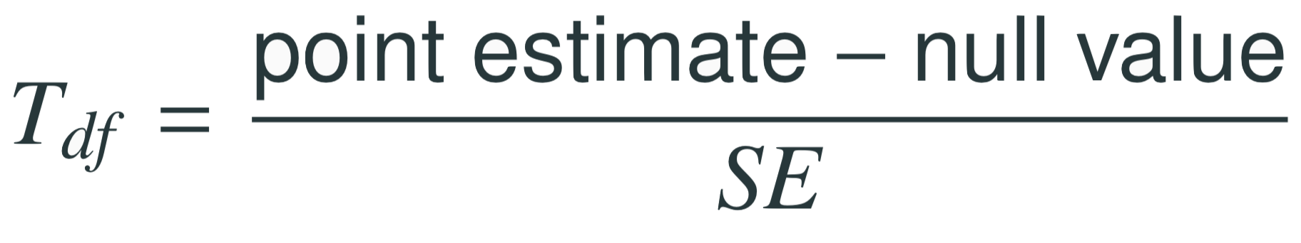
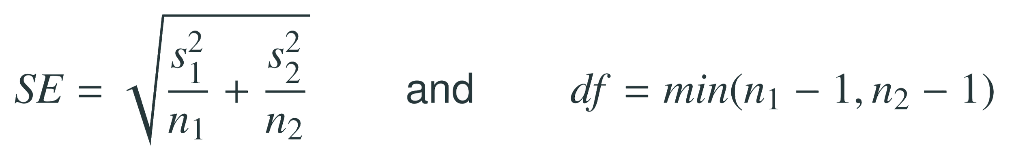
Test statistics
The test statistic for inference on the difference of two means where σ₁ and σ₂ are unknown is the T statistic.
where
Note: The calculation of the df is actually much more complicated. For simplicity we’ll use the above formula to estimate the true df when conducting the analysis by hand

Slide 9
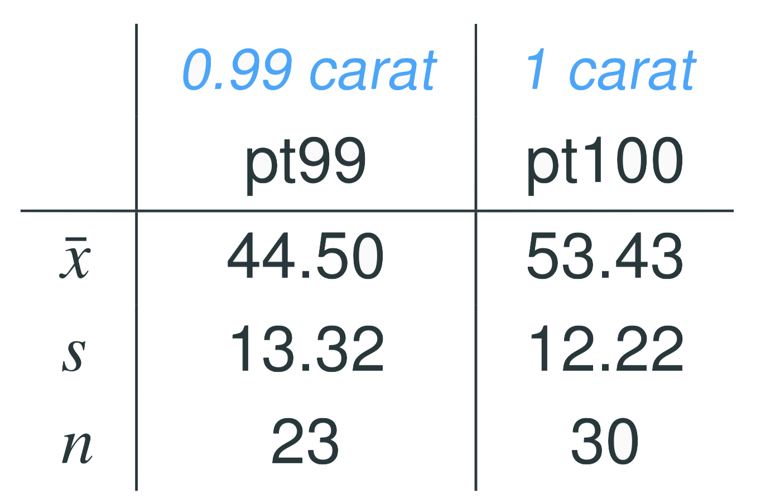
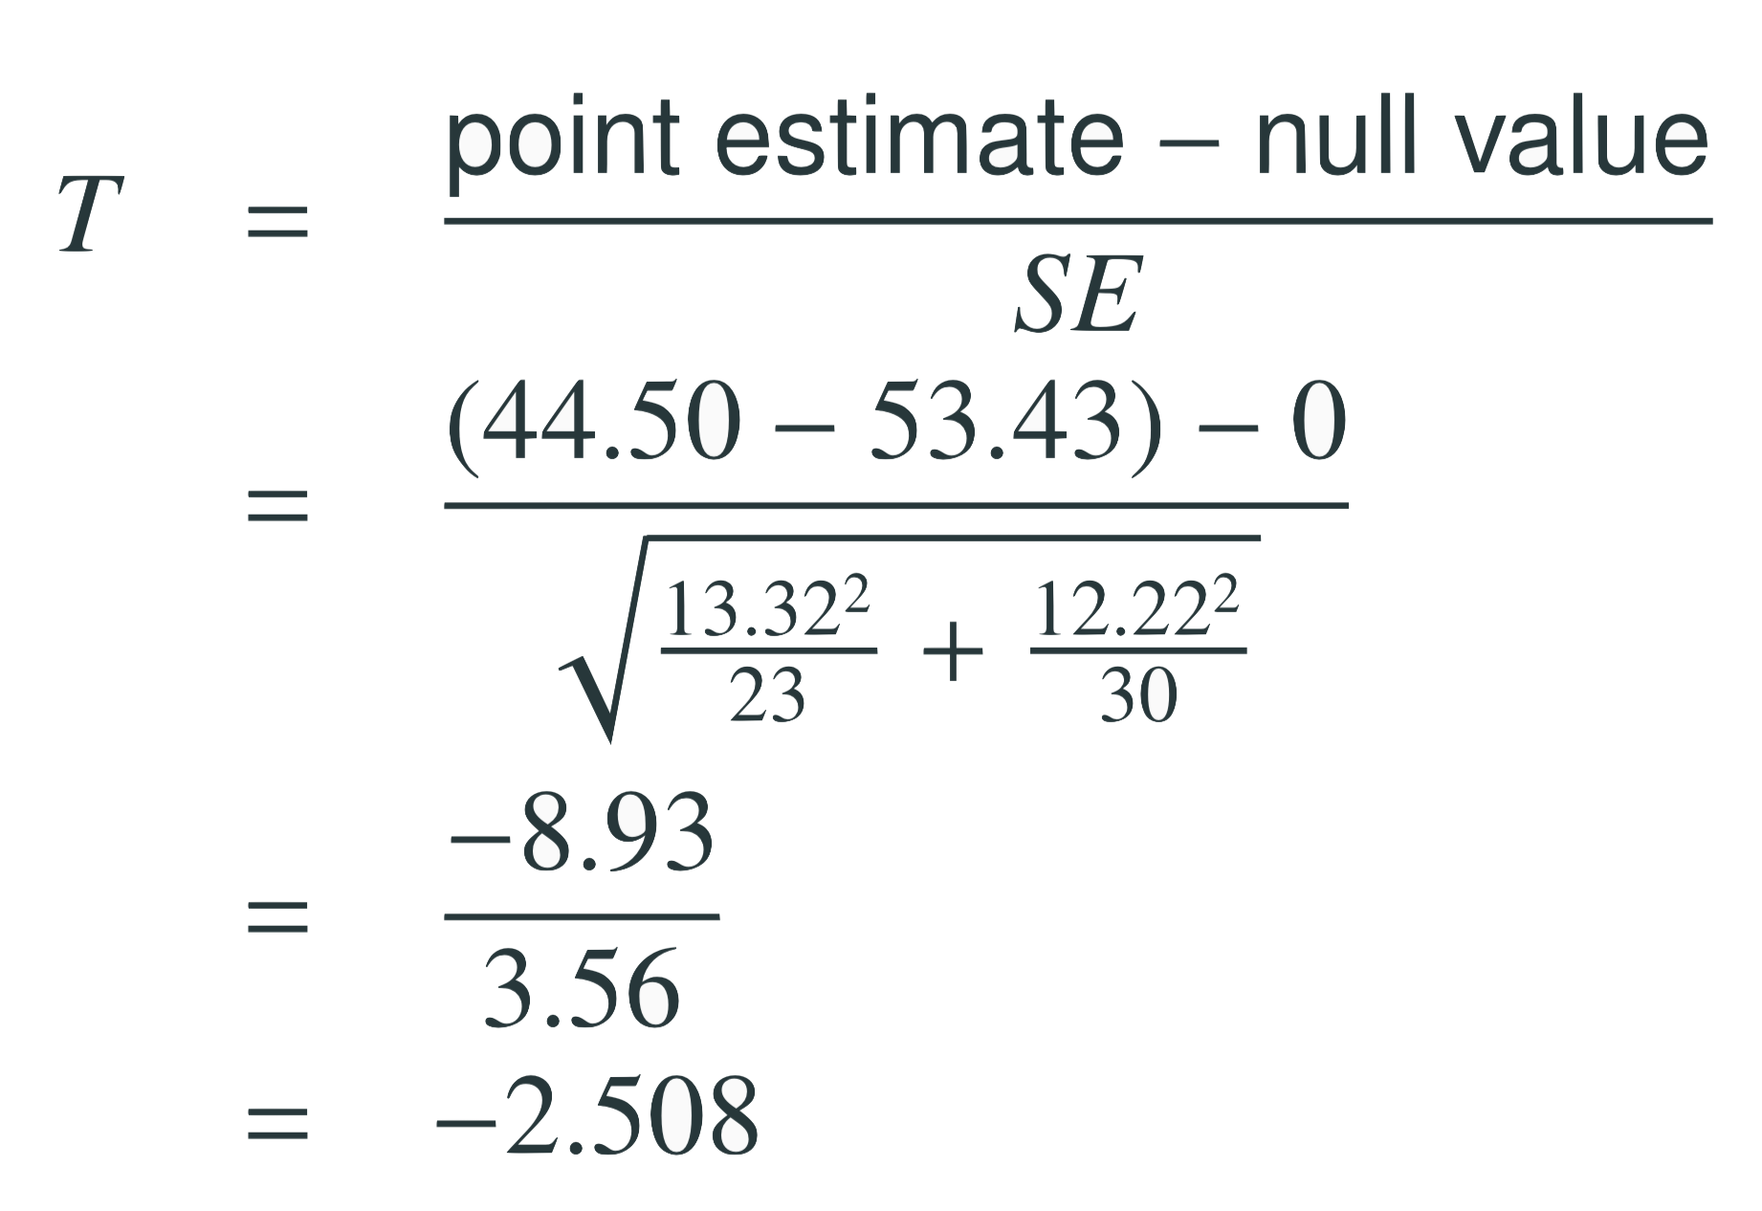
Test statistics (cont.)
In context...

Slide 10
Test statistics (cont.)
In context...

Slide 11
Test statistics (cont.)
Which of the following is the correct df for this hypothesis test?
22
23
30
29
52

Slide 12



Test statistics (cont.)
Which of the following is the correct df for this hypothesis test?
22
23
30
29
52

Slide 13


p-value
Which of the following is the correct p-value for this hypothesis test?
between 0.005 and 0.01
between 0.01 and 0.025
between 0.02 and 0.05
between 0.01 and 0.2

Slide 14
p-value
Which of the following is the correct p-value for this hypothesis test?
between 0.005 and 0.01
between 0.01 and 0.025
between 0.02 and 0.05
between 0.01 and 0.2
> pt(q = -2.508, df = 22)
[1] 0.0100071

Slide 15
Synthesis
What is the conclusion of the hypothesis test? How (if at all) would this conclusion change your behavior if you went diamond shopping?

Slide 16
Synthesis
What is the conclusion of the hypothesis test? How (if at all) would this conclusion change your behavior if you went diamond shopping?
p-value is smaller than α (0.05) so reject H₀. The data provide convincing evidence to suggest that the point price of 0.99 carat diamonds is lower than the point price of 1 carat diamonds
Maybe buy a 0.99 carat diamond? It looks like a 1 carat, but is significantly cheaper

Slide 17

Confidence interval
Calculate the interval, and interpret it in context

Slide 18

Confidence interval
Calculate the interval, and interpret it in context
Calculate the 90% confidence interval for $μ_{1}−μ_{2}$ :

Slide 19

Confidence interval
Calculate the interval, and interpret it in context
Calculate the 90% confidence interval for $μ_{1}−μ_{2}$ :
We are 90% confident that the average point price of a 0.99 carat diamond is $15.05 to $2.81 lower than the average point price of a 1 carat diamond

